Slide 1
Simple CI/CD Project.
Project creator: Ivan Samoilenko
Presenation design: EPAM

Slide 2

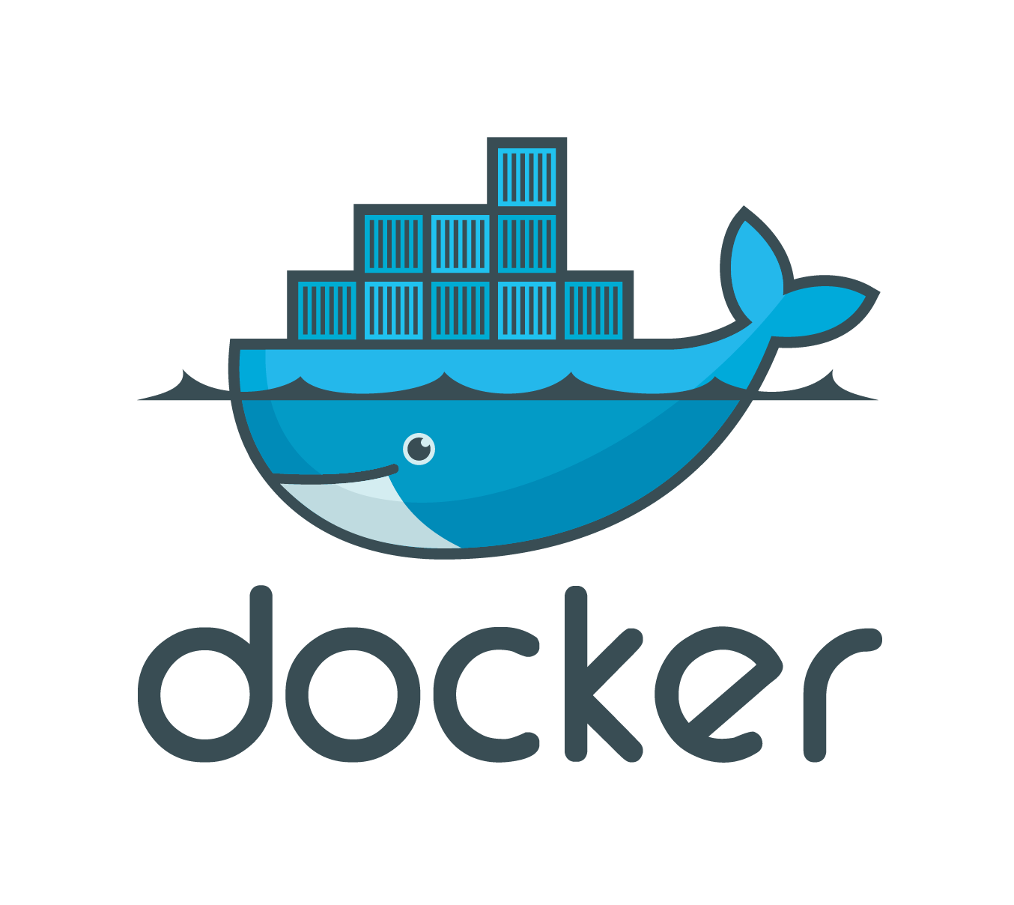

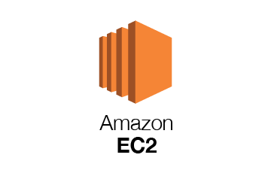


Scheme of my project using Ansible, GIT, Jenkins, AWS EC2, Docker.
PUSH

Slide 3
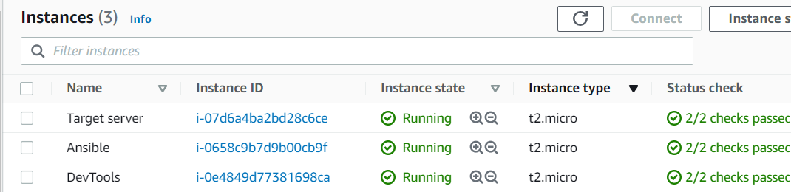
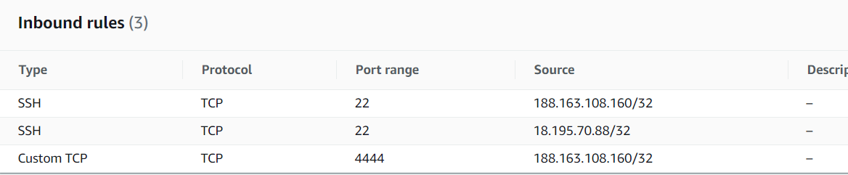
Create AWS instances:
Manage security groups:

Slide 4
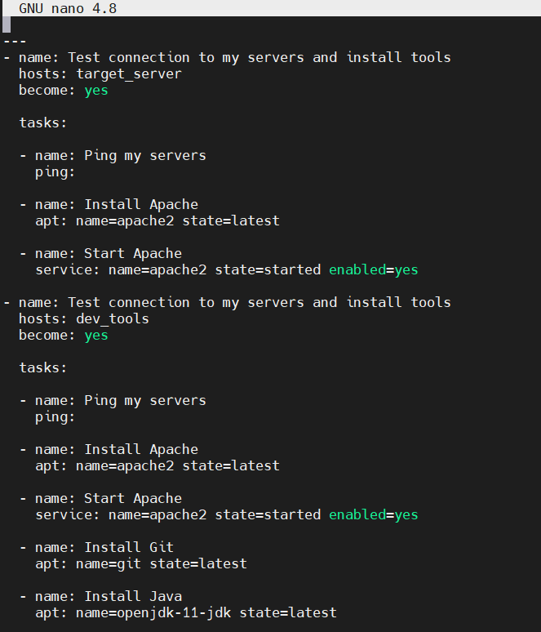
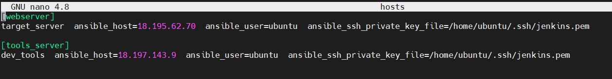
Creating Ansible playbook:
Inventory file:

Slide 5
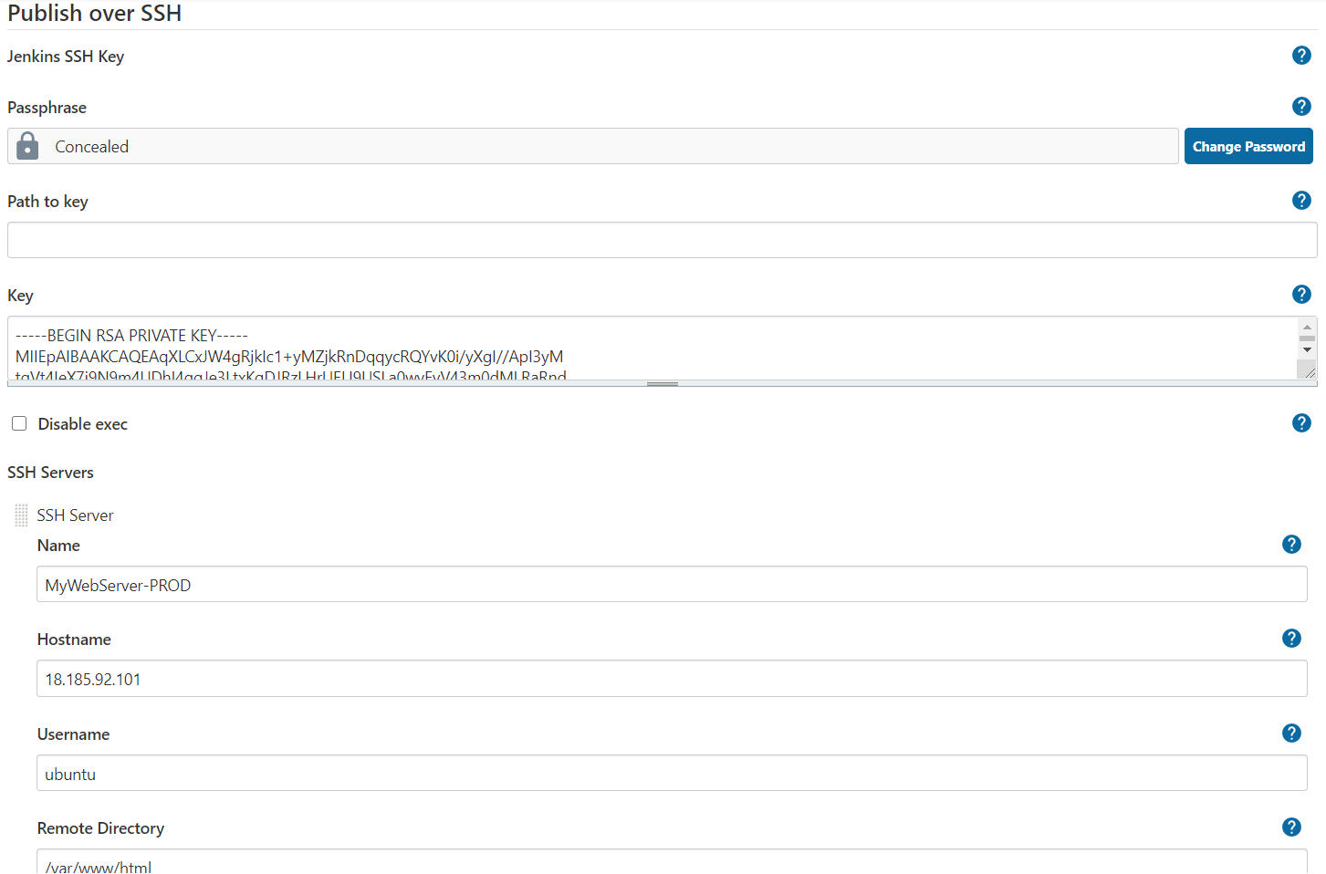
Jenkins: connection to target AWS instance

Slide 6
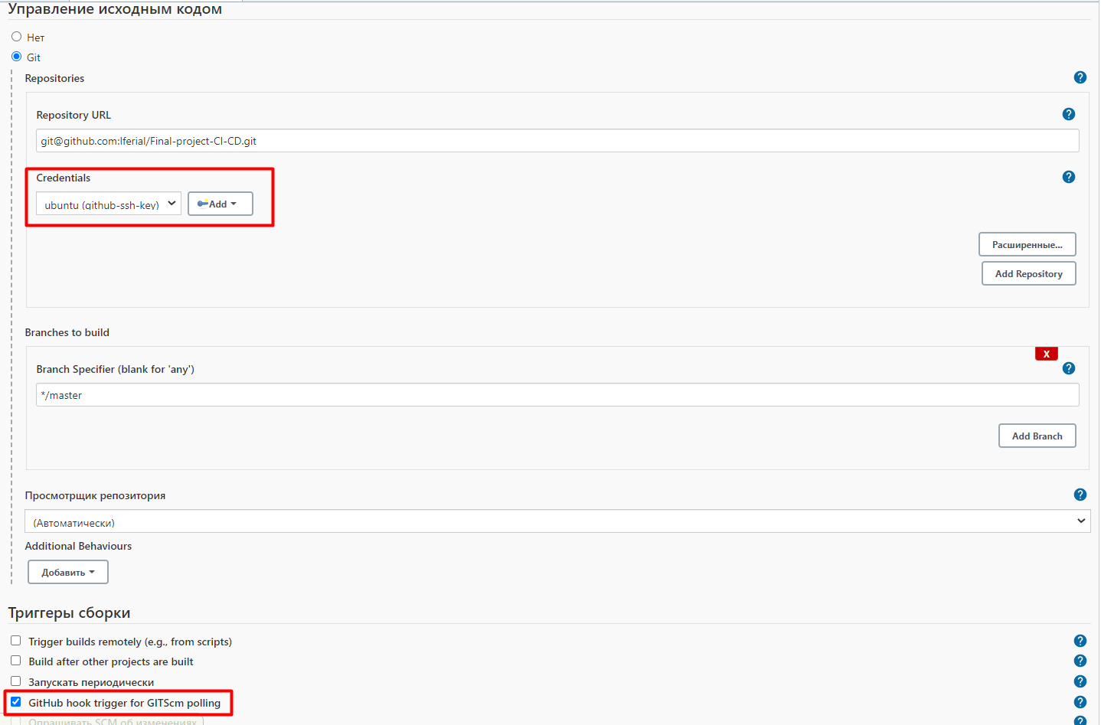
Connection with Github

Slide 7
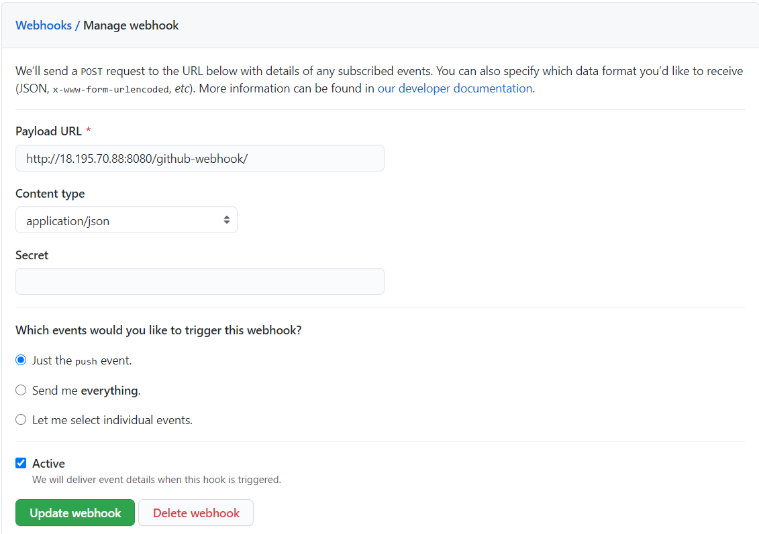
Managing Github webhook

Slide 8
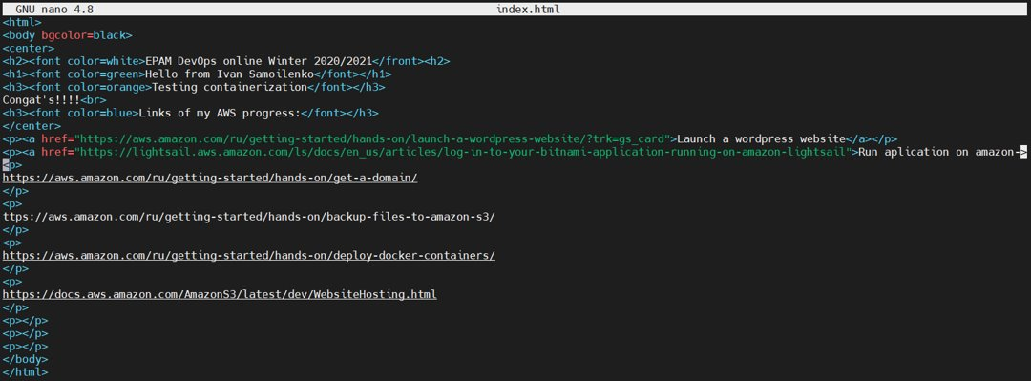
HTML web page

Slide 9
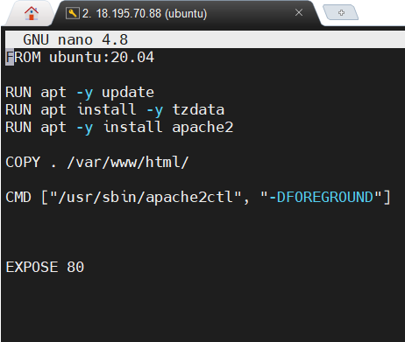
Dockerfile

Slide 10
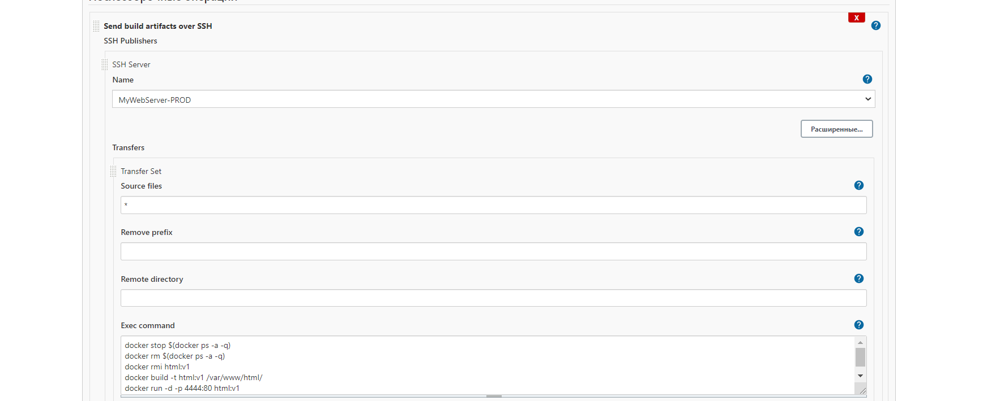
Sending artifacts

Slide 11
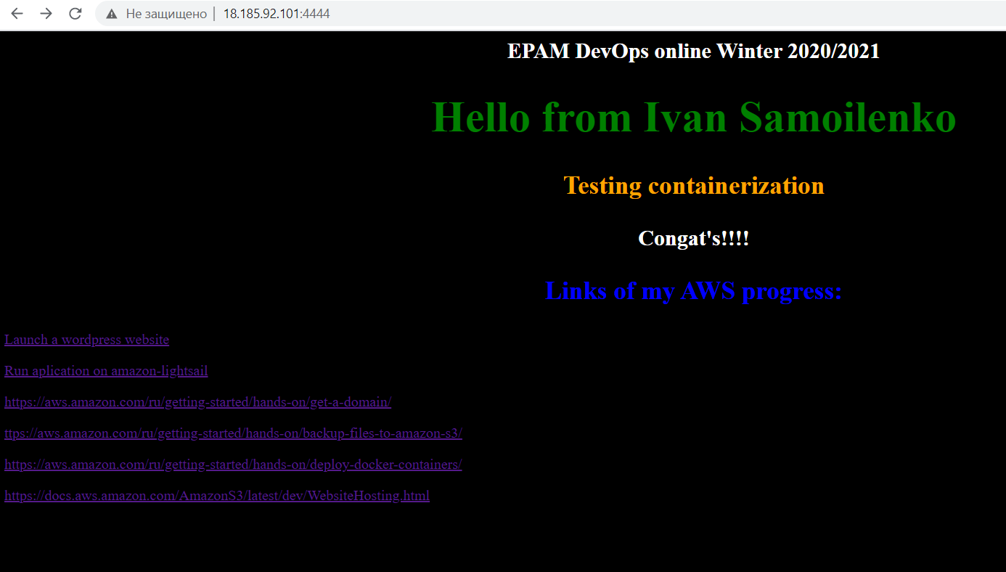
HTML page on target server in container

Slide 12
Q&A

Slide 13
Thank you!

